Slide 1
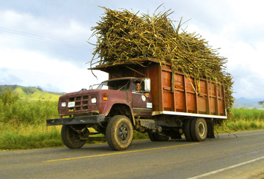
Decision Support System for Sugar Regulatory Administration

Slide 2

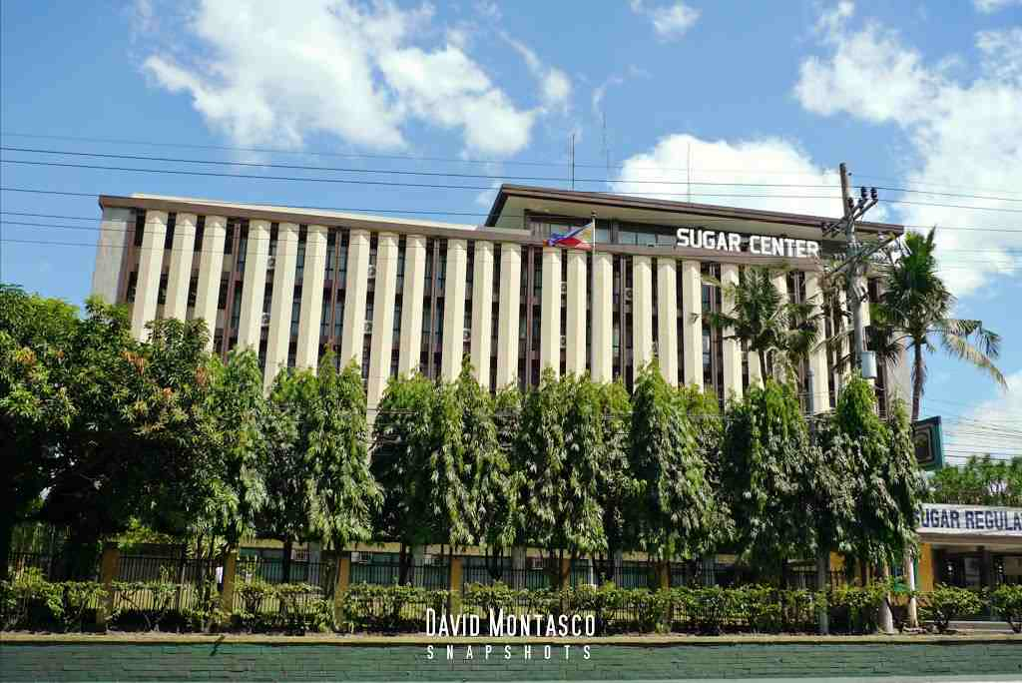
Company Background
Formed: March 28, 1986
Objectives
Institute an orderly system in sugar production
Establish and maintain a balanced relation between production and marketing conditions to ensure balanced prices
Advocate the effective merchandising of sugar and sugar products in the domestic and foreign markets
Services
Regulatory Services
Production Support Services
Extension Support Services
Policy and Information Support Services
Institutional Strengthening Program

Slide 3
Research Development & Extension Department
The department implements the block farm program for sugarcane farmers, transfers developed technologies on sugar production and sugarcane farming, gathers farm inventory, crop estimates; implements outreach programs for trainings of sugarcane farmers on farm practices and technologies; coordinates with MDDCs in implementing programs and projects.

Slide 4


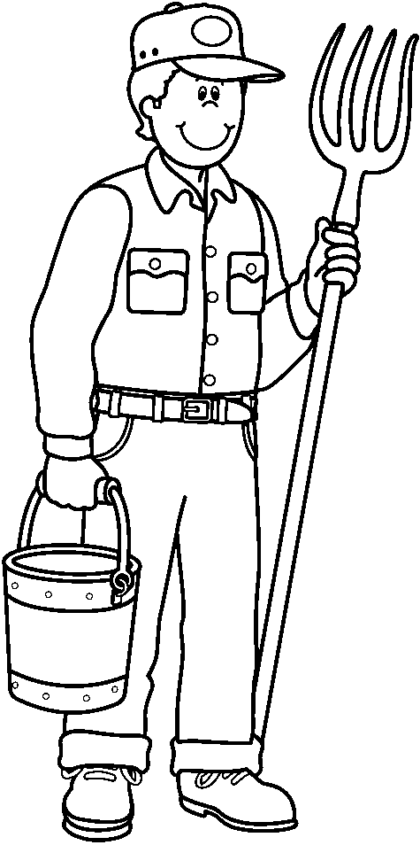
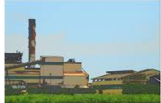
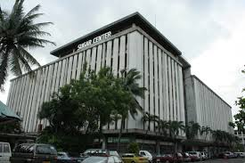
Organizational Processes
Agriculturists
Farm B
Farm A
Mill
Farm C
Farm D

Slide 5
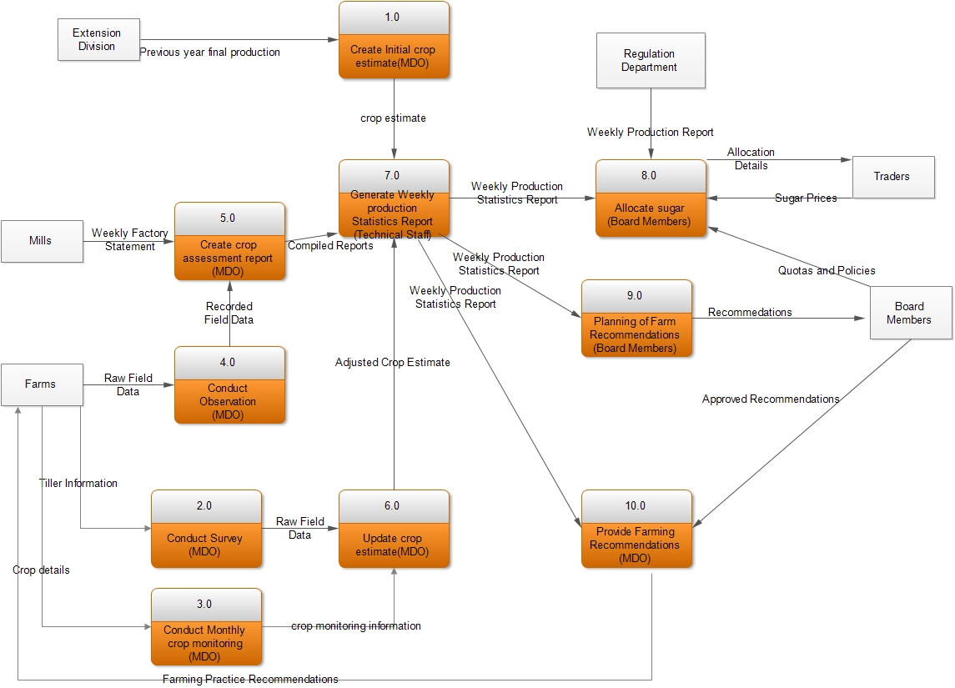
Organizational Processes

Slide 6
Problem Analysis

Slide 7
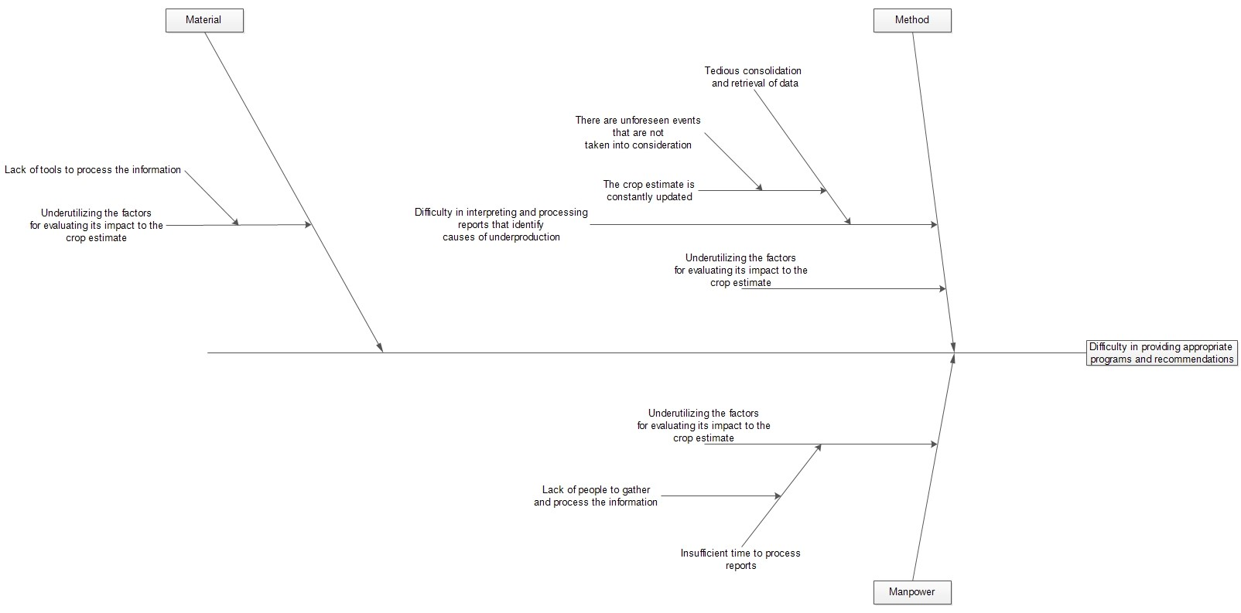

Slide 8
Conceptual Framework

Slide 9
